Slide 1

2. Data exploration
DSCI 5240 Data Mining and Machine Learning in Business

Slide 2
Today’s agenda
Understand data – where they come from
01
Understand data – measurement levels
02
Explore data using Python
03

Slide 3
Customer data - Framework
Demographics: age, gender, zip code, education, income…
Psychographics: interests, lifecycle stage, attitudes, beliefs…
Technographics: how long they are online every week, data usage, equipment, apps/tools
Transactions: plan, how much they spend on the plan
Consumption and usage: data usage, voice usage
Interactions: complaints, number of times to call service, network issues; marketing promotions; events

Slide 4
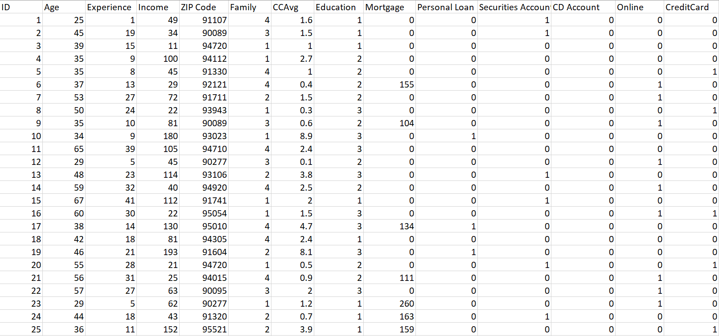
Sample customer data of a bank

Slide 5
Where do they come from?
Internal
Customer relationship management systems: Relational databases
Transaction systems: relational databases
Surveys: e.g., customer satisfaction survey – data in files
Server logs: customer usage data
Voice files/NoSQL: e.g., customer calls to service centers
External
Purchased from data providers
Social media: web scraping

Slide 6
Data storage
Files
Text files: .csv (comma separated values)
Log files: machine data
Web files: HTML, XML, JSON
Application-specific files: Word, PowerPoint, Excel
Databases: organized collection of data
Relational databases
Other types of databases: object-oriented, key-value databases, etc.

Slide 7
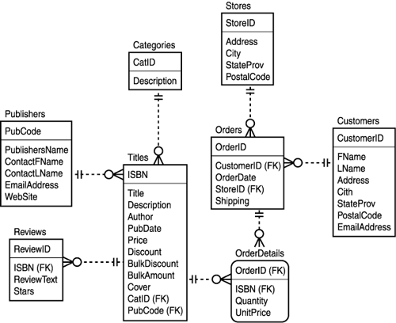
A relational Database
The most common type of database system
Information stored in two dimensional tables with defined set of relationships among them
Efficient and intuitive

Slide 8
Measurement levels of variables

Slide 9
Measuring Objects
Customers, products, companies, and any other “object” are described by their attributes (satisfaction, price, innovativeness…)
Attribute, dimension, feature, and variable are often used interchangeably
Attributes may vary from one object to another (cross-sectional) or from one time to another (longitudinal).
To measure attributes, we assign numbers or symbols to them

Slide 10

Nominal Measure
Color of horses
Symbols or names of things
Valid operations: =, ≠
No intrinsic ordering
 | Battleship | Black Gold | Bushranger
Color | White | Black | Brown

Slide 11
Binary Measure
Gender of the horse
Nominal attribute with only two categories or states
0 or 1
Examples:
Smokers: yes/no
Medical test: positive/negative
Gender: male/female
 | Battleship | Black Gold | Bushranger
Gender | M | M | F

Slide 12
Ordinal Measure
Position results in race
 | Battleship | Black Gold | Bushranger
Race 1 | 1st | 2nd | 3rd
Race 2 | 2nd | 3rd | 1st
Race 3 | 3rd | 1st | 2nd
Race 4
Meaningful order or ranking
But the distance between ordinal measures has no accurate meaning: the difference between 1st and 2nd ≠ the difference between 2nd and 3rd
Valid operations: =, ≠, >, ≥ ,<, ≤
You cannot perform arithmetic operations on them

Slide 13
Interval Measure
Total time used
 | Battleship | Black Gold | Bushranger
Race 1 | 120 s | 122.4s | 122.7s
Race 2 | 118.2s | 121.3s | 118s
Race 3 | 122.3s | 122s | 122.2s
Race 4 | 121.1s | 121s | 123.7s
Measured on a scale with meaningful difference
We can perform meaningful arithmetic operations on them
In Race 1, Black Gold is 122.4/120 = 1.02 times slower than Battleship (or, 2% slower).
Valid operations: =, ≠, >, ≥ ,<, ≤, +, -, x, /,…

Slide 14
Levels of Measurement
An attribute can be measured at a certain level or any lower level, e.g.,
horse-speed intrinsically interval-scaled
Can be measured as ordinal
So
An interval-scaled attribute can be measured by interval, ordinal or nominal measures
An ordinal-scaled attribute can be measured by ordinal or nominal measures, but NOT interval
Nominal attributes can only have nominal measures
Caution: Measuring at a lower level loses information and limits possible analyses
Interval
Ordinal
Nominal

Slide 15
Variable types
Categorical variables
Interval variables
With categorical variable
Binary
Ordinal
Nominal
Different names for interval
Numeric variables
Continuous variables

Slide 16
What is the measurement scale?
During which season of the year were you born?
_____winter _____spring _______summer _______fall
What is your total household income? _______________
Which are your three most preferred brands of beer? Rank them from 1 to 3 with 1 being most preferred.
Tsing Tao___ Heineken____ Corona____ Budweiser____ Carlsberg_____
How satisfied are you with the labor day shopping experience?
___very satisfied ___satisfied ____neutral ___dissatisfied ___very dissatisfied

Slide 17
Data exploration
To present data in a form that makes sense to people so that we can have a general idea about the data and find directions for further analysis
single variable
relationships between variables
Methods to explore:
Statistics
Descriptive statistics: counts, percentages, averages, and measures of variability, etc.
Tables
Graphs: bar chart, line chart, histograms, scatterplots, box plots and time series graphs, etc.

Slide 18
Single variable

Slide 19
Single variable statistics
Categorial variables
Count the number of observations in each category
Frequency distribution: frequency of observations in each category
Interval variables
Measures of central tendency
Mean, Median
Minimum, Maximum, Percentiles, and Quartiles
Measures of dispersion/variability
Variance
Standard deviation
Measures of distribution shape
Skewness: occurs when the sample is lack of symmetry
Kurtosis: this is all about the extreme observations.

Slide 20
Measures of Central Tendency
Arithmetic Mean
Affected by unusually large or small observations (outliers)
Median
Middle value when data are ordered from smallest to largest.
Not affected by extremes

Slide 21
Minimum, Maximum, Percentiles, and Quartiles
Minimum and Maximum
For any percentage p, the pth percentile is the value such that a percentage p of observations are smaller than it.
The quartiles divide the data into four groups, each with (approximately) a quarter of all observations.
The first, second and third quartiles are the percentiles corresponding to p = 25%, p = 50%, and p = 75%.
By definition, the second quartile (p = 50%) is equal to the median.

Slide 22
Measures of Dispersion
Variance
Population Sample
Standard Deviation
= Square root of variance
The standard deviation has the same units of measurement as the original data, unlike variance

Slide 23
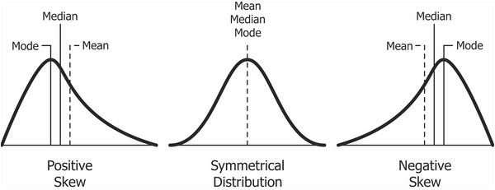
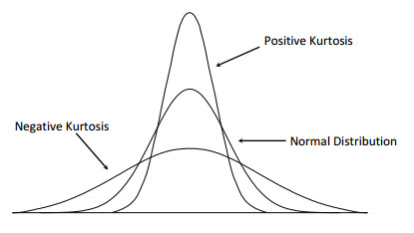
Measures of Distribution Shape (optional)
Distribution of numeric variables
Skewness (CS)
-0.5 < CS < 0.5 indicates relative symmetry
Kurtosis
Refers to the peakedness or flatness of a distribution, The lower the kurtosis, the flatter the distribution.
CK < 3: more flat with wide degree of dispersion
CK >3 more peaked with less dispersion

Slide 24
Distribution graphs
Categorial variables
Bar chart: Display frequency distribution - “how many” observations in each category
Interval variables
Histogram: Display “how many” observations in each of the bins occur in a data set
Box plot: Quartiles

Slide 25
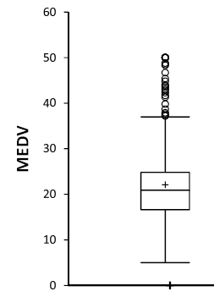
Box Plots
A box plot (or box-whisker plot) is an alternative type of chart for showing the distribution of a variable
The elements of a generic box plot:
Top outliers defined as those above Q3+1.5(Q3-Q1).
“max” = maximum of non-outliers
“min” = minimum of non-outliers
IQR = Q3-Q1: Interquartile range
outliers
“max” = Q3+1.5(Q3-Q1)
Quartile 3
Median
Quartile 1
“min” = Q1-1.5(Q3-Q1)

Slide 26
Outliers
An outlier is a value or an entire observation (row) that lies well outside of the norm.
Some statisticians define an outlier as any value more than three standard deviations from the mean, but this is only a rule of thumb
Domain knowledge is required to decide whether an “outlier” is truly an error, an abnormal or a special case
What to do with outliers:
Careful review for more information to make decisions
Remove if confirmed to be errors or unexplained abnormal

Slide 27
Multiple variables

Slide 28
Two interval variables
Statistics
Covariance
Graphs
Scatterplot
Correlation
Correlation heatmap

Slide 29
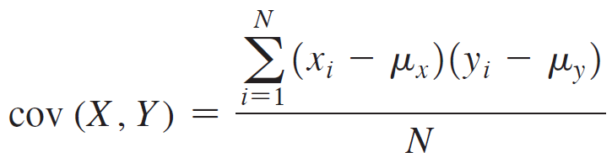
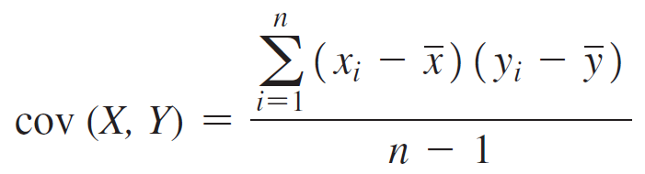
Relationship: two continuous variables - Covariance
A measure of the linear association between two (continuous) variables, X and Y.
For a population, COVARIANCE.P:
For a sample, COVARIANCE.S:

Slide 30
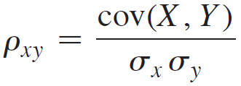
Relationship: two continuous variables - Correlation
A measure of the linear association between two variables, X and Y.
The scale of measurement is normalized
The correlation value is always between -1 and +1.

Slide 31
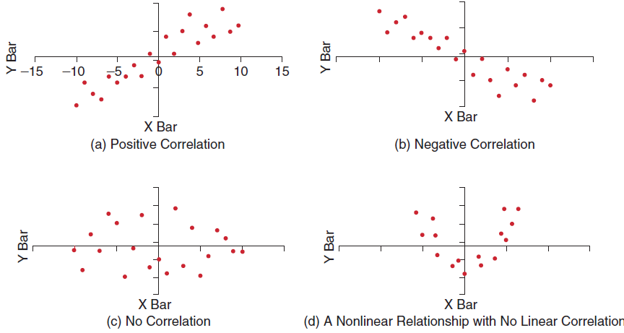
Correlation
Correlation is linear concept; it may not be able to recover nonlinear relationships.

Slide 32
One interval vs. one categorical
Statistics
Compare the distribution of the interval variable in each category
Graphs
Side-by-side plots across categories
Or subplots of each category

Slide 33
Take-away for today
Where data come from
Measurement levels
Single variable exploration
Categorical variables: frequency count, bar chart
Continuous variables: summary statistics, histogram, boxplot
Multiple variable exploration
Two continuous variable: covariance, correlation, scatterplot, heatmap
A continuous variable vs. a categorical variable: comparison of statistics, boxplots across categories

